Slide 1
Workflow
Workflow
Lecture 1
By James(Jin) Wang
07/2020

Slide 2
Outline
Company Structure and Teams
Agile Methodology
Interview Techniques
Portfolio
Job Hunting

Slide 3
Company Structure and Teams
  Company trees and teams
Accenture
...
SPM
AFS
...
Andrei
USPS
James
Sachi
Peter
...
SPM
PW
MWI
Josh
Elon

Slide 4
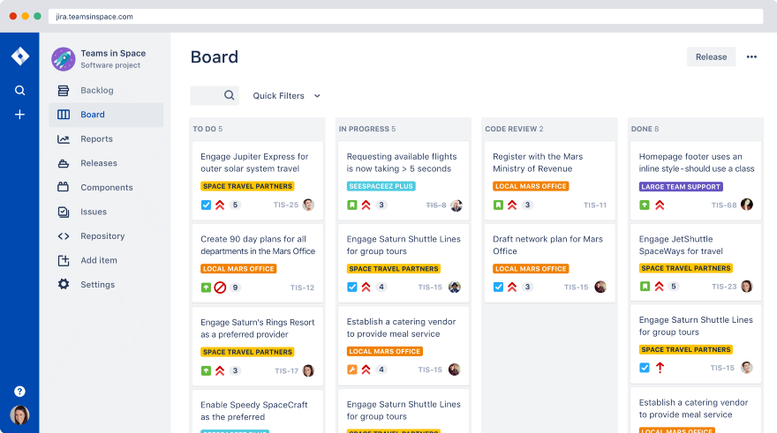
Agile Methodology
  Team Board
  1 Sprint = 2 Weeks

Slide 5
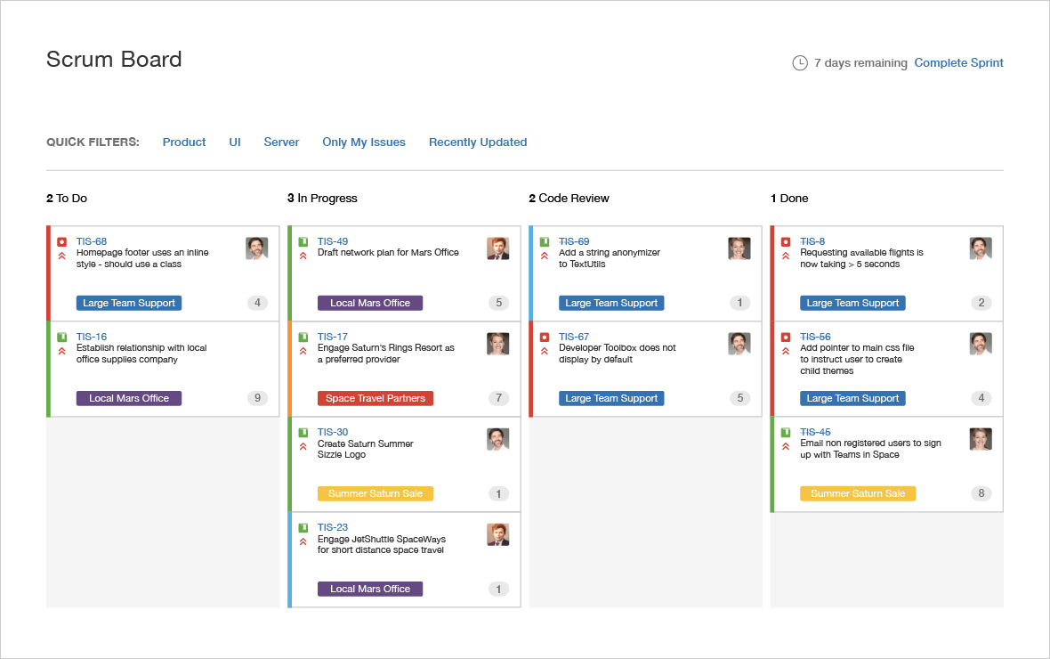
Agile Methodology
  Individual Board

Slide 6
Agile Methodology
  Mockups from QA or product manager
  examples:
  https://uf0u9v.axshare.com/iv_dashboard.html
  https://uf0u9v.axshare.com/containers-at-risk.html

Slide 7
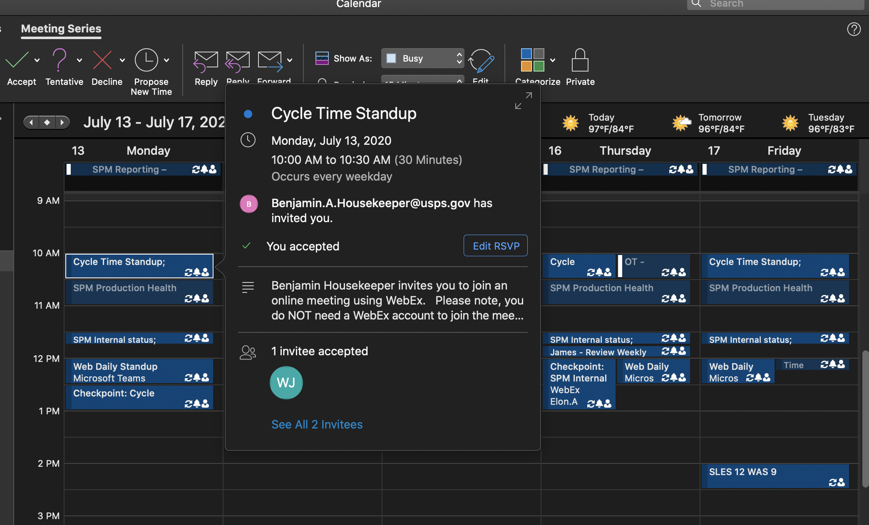
Agile Methodology
  Daily Standup Meeting

Slide 8
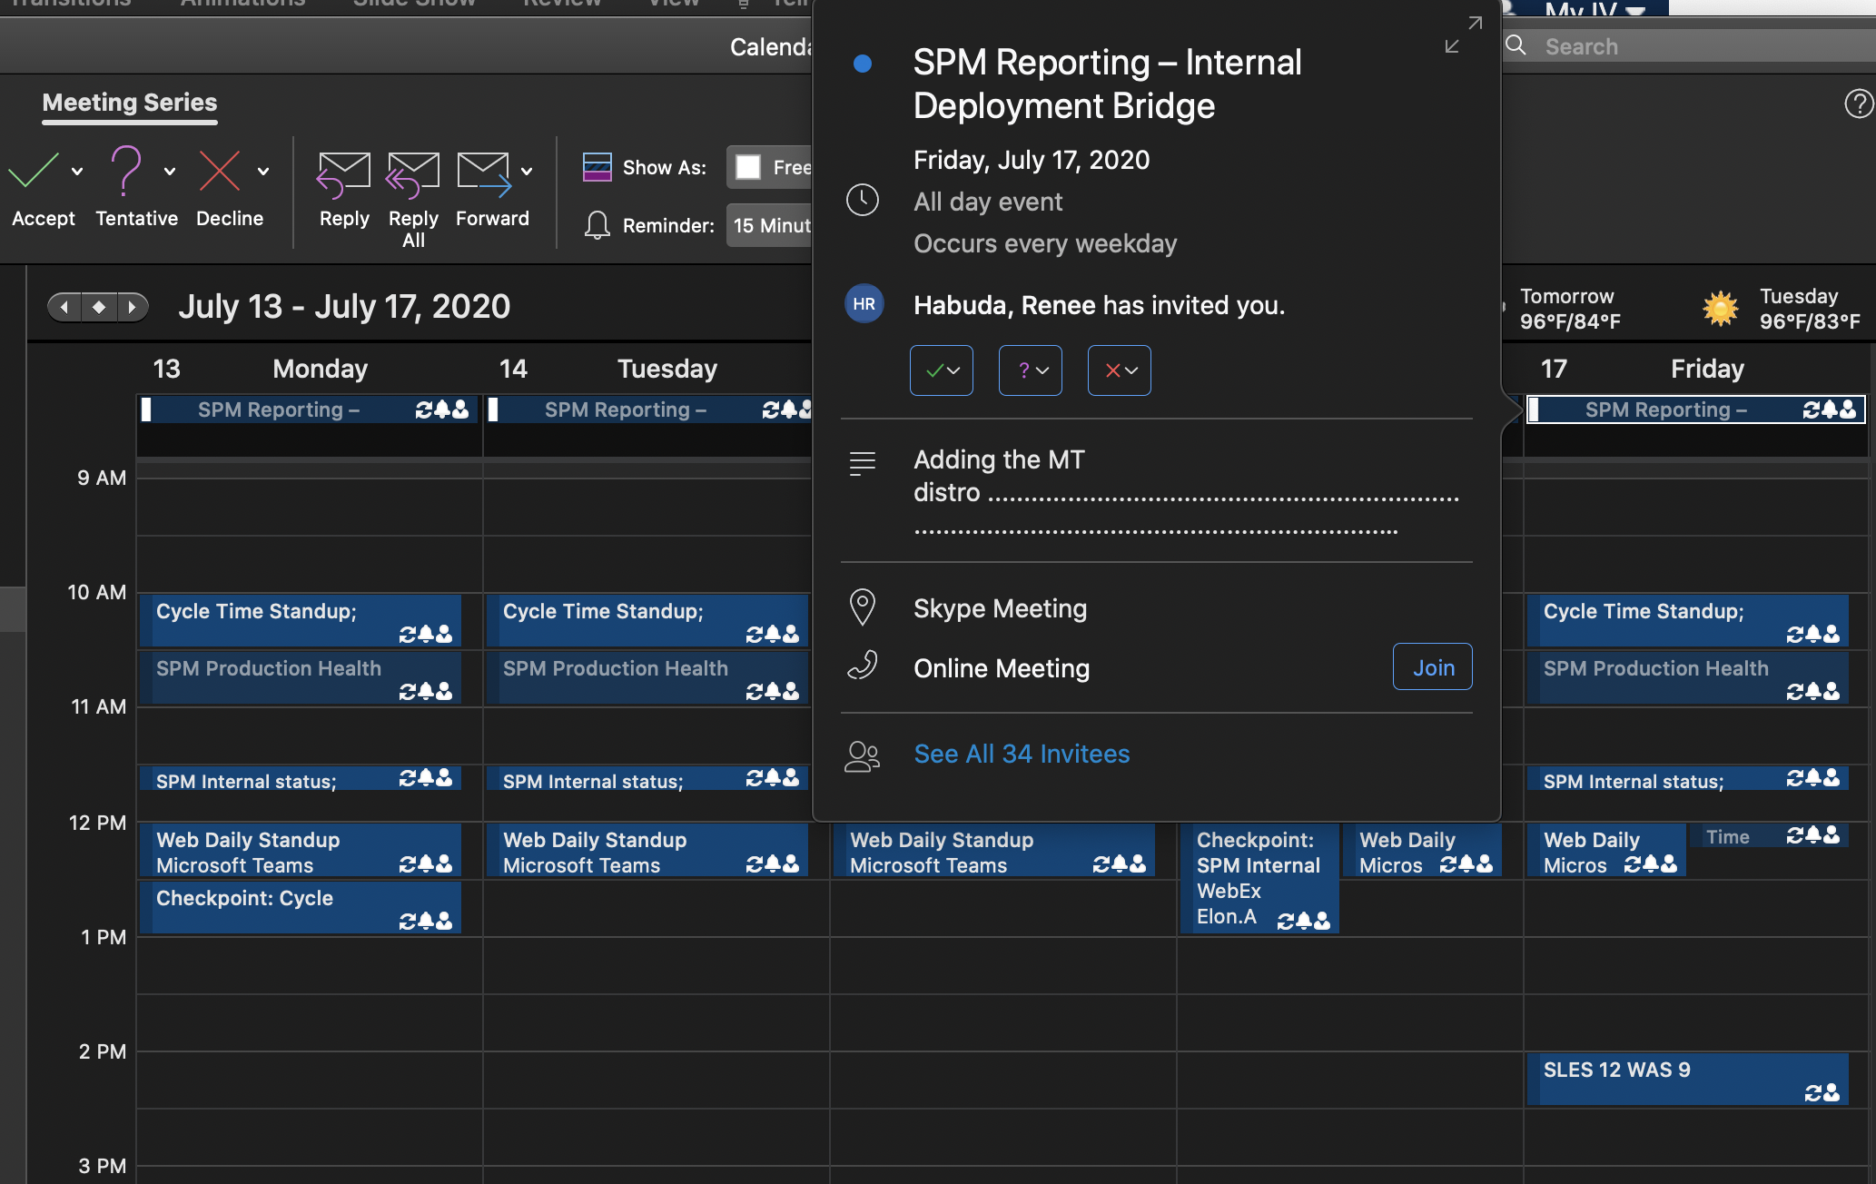
Agile Methodology
  Deployment Meeting
  End of each Sprint

Slide 9
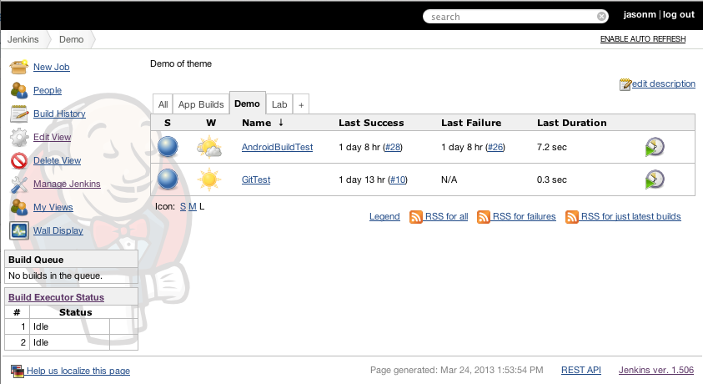
Agile Methodology
  Deploy to Jenkins

Slide 10
Agile Methodology
  Integrated Testing
  Deployement procedure:
  SIT:
  https://tivreporting.usps.gov/ivui_beta
  https://tivreporting.usps.gov/ivui
  https://divreporting.usps.gov/ivui
  Beta:
  https://iv.usps.gov/ivui_beta
  Live:
  https://iv.usps.gov/ivui

Slide 11
Interview Techniques
  Coding test:
  Algorithm test
  Project test
  Project test:
  Give an url, write Service, Component, HTML
  Communicate between components
  Custom Pipes
  Unit test

Slide 12
Portfolio
  On Github
  On AWS
  https://aws.amazon.com/getting-started/hands-on/host-static-website/?nc1=h_ls
  https://aws.amazon.com/rds/
  https://aws.amazon.com/route53/
  https://aws.amazon.com/ec2/

Slide 13
Job Hunting
  Indeed.com
  Dice.com
  Monster.com
  Careerbuilder.com

Slide 14
Summary

